Slide 1
Music Genres
Classification
Team 7 Mozart

Slide 2
About Music Genres Classification
Concept
Approaches
GTZAN Dataset
Data
Classes
Approaches
Basic ML
CNN
LSTM
Conclusion
References
Contents

Slide 3
Concept
Human identifies music genres intuitively
Rock, Pop, Blues …
Computer?
Extract Features
-> Music Genres Classification

Slide 4
Approaches
Simply Using Basic ML Classifier
Extract Spectrogram Images -> CNN
LSTM with Audio File as Sequential Data

Slide 5
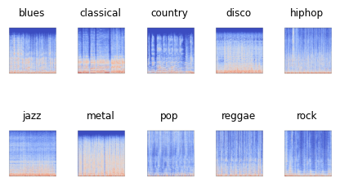
Approaches
Simply Using Basic ML Classifier
Extract Spectogram Images -> CNN
LSTM with Audio File as Sequential Data

Slide 6
GTZAN dataset
Audio (.wav)
10 genres, 100 audio files for each genre
30 seconds
Image
Mel Spectrograms
Tabular(.csv)
Means and variances of features extracted from audio files with 3 seconds and 30 seconds.

Slide 7

GTZAN dataset
Audio (.wav)
10 genres, 100 audio files for each genre
30 seconds, splitted by 3 seconds (augmented)
Image
Mel Spectrograms
Tabular(.csv)
Means and variances of features extracted from audio files with 3 seconds and 30 seconds.

Slide 8
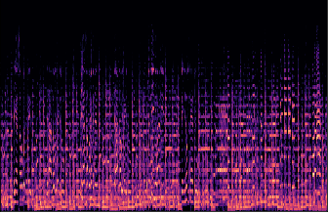
GTZAN dataset
Audio (.wav)
10 genres, 100 audio files for each genre
30 seconds
Image
Mel Spectrograms
Tabular(.csv)
Means and variances of features extracted from audio files with 3 seconds and 30 seconds.

Slide 9
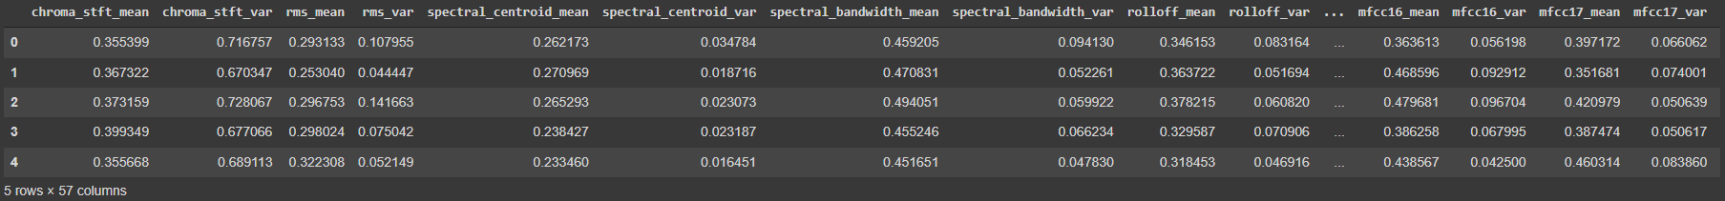
GTZAN dataset
Audio (.wav)
10 genres, 100 audio files for each genre
30 seconds
Image
Mel Spectrograms
Tabular(.csv)
Means and variances of features extracted from audio files with 3 seconds and 30 seconds.

Slide 10
GTZAN dataset
10 Classes
'classical'
'country'
'disco'
'rock'
'reggae'
'hiphop'
'jazz'
'metal'
'pop'
'blues'

Slide 11
Approaches
Augmentation - Failed due to lack of time
Basic ML
XGBoost, Simple Neural Network
CNN
Simple CNN
LSTM
Advanced Algorithm of RNN

Slide 12
Basic ML Algorithm - XGBoost
XGBoost
eXtreme Gradient Boosting
Boosting = A method of Ensemble
Ensemble = Structuring strong algorithm using multiple weak algorithms

Slide 13
XGBoost
XGBoost
Gradient Boosting = Boosting with decision tree
Fast, Good results
Easy to find importance of features

Slide 14
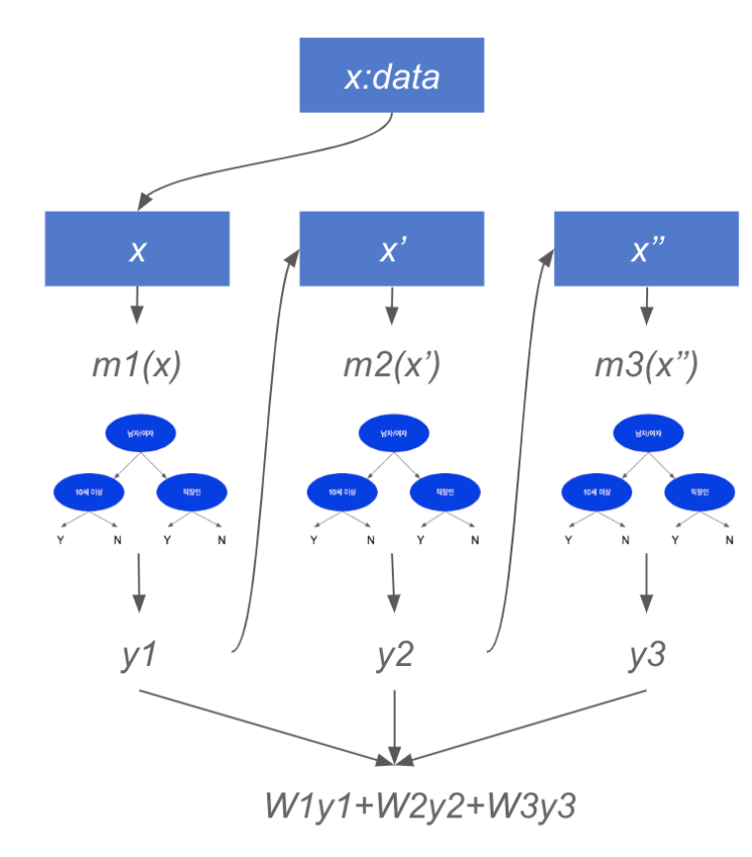
XGBoost
XGBoost
Gradient Boosting = Boosting with decision tree
Fast, Good results
Easy to find importance of features

Slide 15
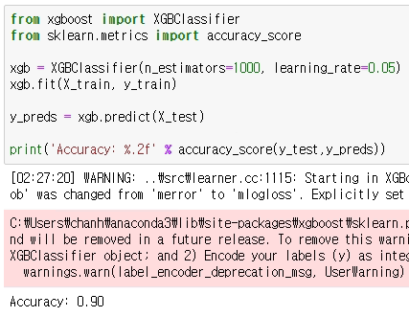
Source Code of XGBoost
Accuracy : 0.90

Slide 16
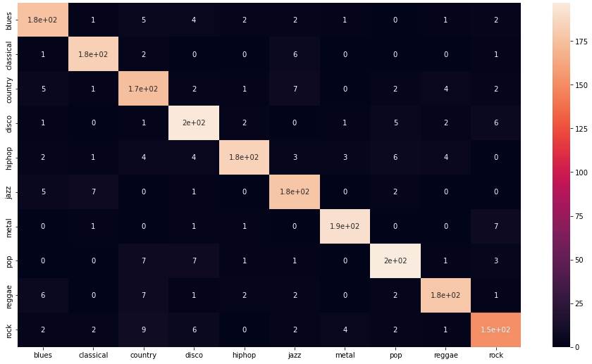
Results of XGBoost
Accuracy = 0.90
Confusion Matrix

Slide 17
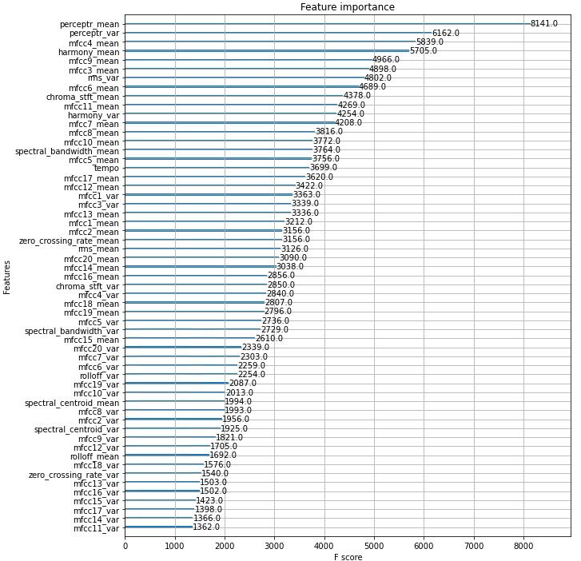
Feature
Importance
of XGBoost

Slide 18
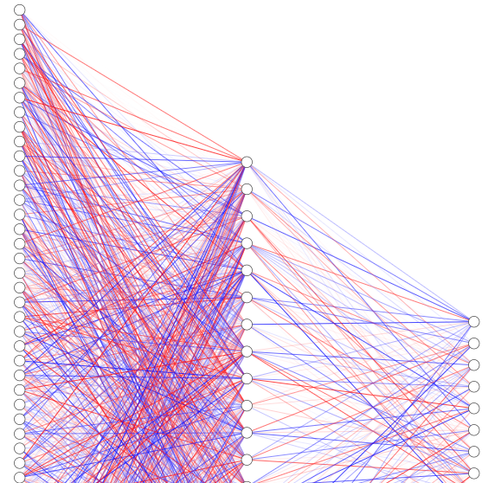
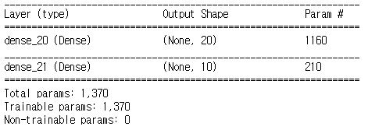
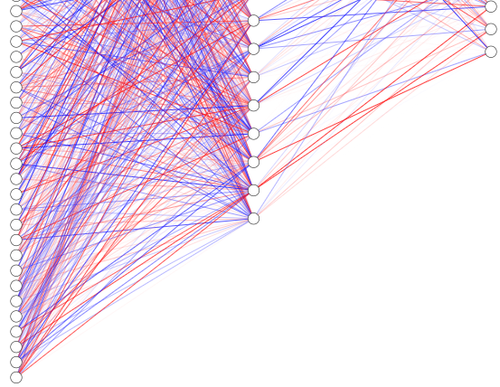
Simple
Neural Network
1 Hidden Layer
Model Summary

Slide 19
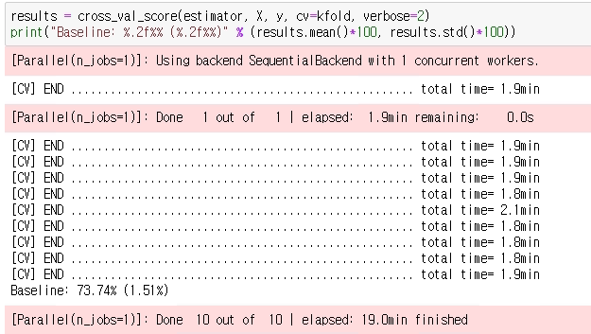
Simple
Neural Network
Result
Accuracy 73.74%

Slide 20
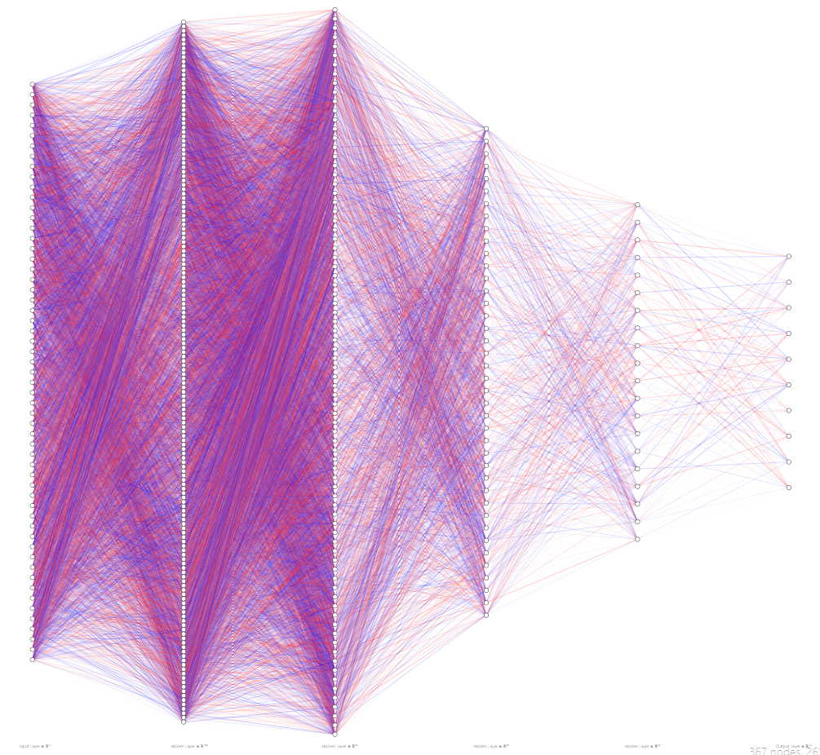
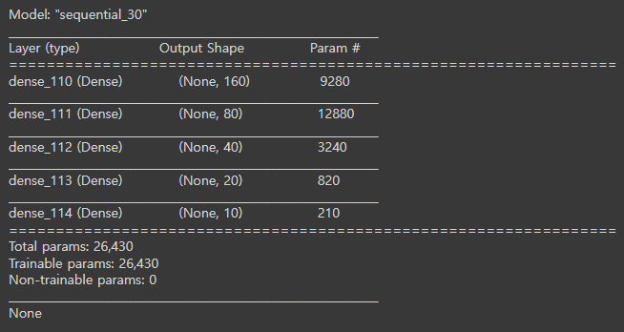
Deeper
Neural Network
4 Hidden Layers
Model Summary

Slide 21
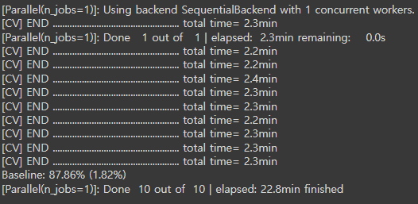
Deeper
Neural Network
Result
Accuracy 87.86%

Slide 22
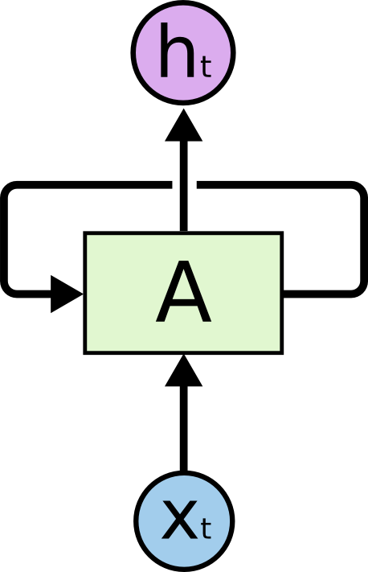
LSTM
Long Short-Term Memory
Part of RNN
Can avoid RNN’s “Vanishing gradient problem”
Consist of cells, input gates, output gates, forget gates
Simple figure of RNN

Slide 23

RNN
RNN A get X as input data and export h as output data.
It shows that iteration between A that the network in the next step receives information from the previous step.
But, if gap that require to get information is getting bigger, it’s hard to learn.

Slide 24
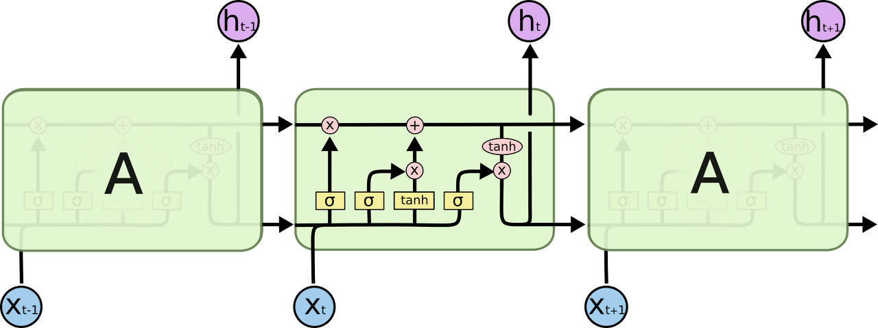
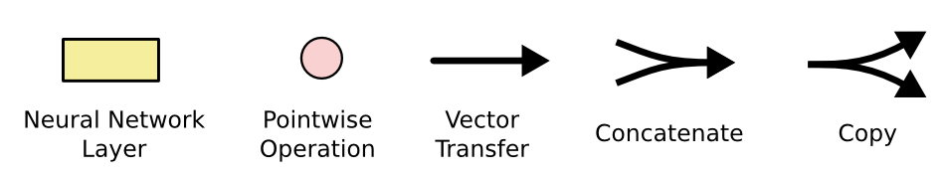
LSTM
4 Layers
Like RNN, the LSTM also has a chain-like structure.
Unlike RNN, each iteration module has different structure.
Instead of a simple neural network layer, four layers are supposed to exchange information with each other in a special way

Slide 25
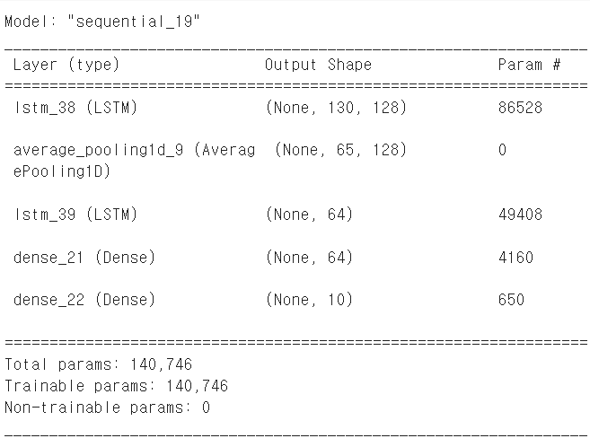
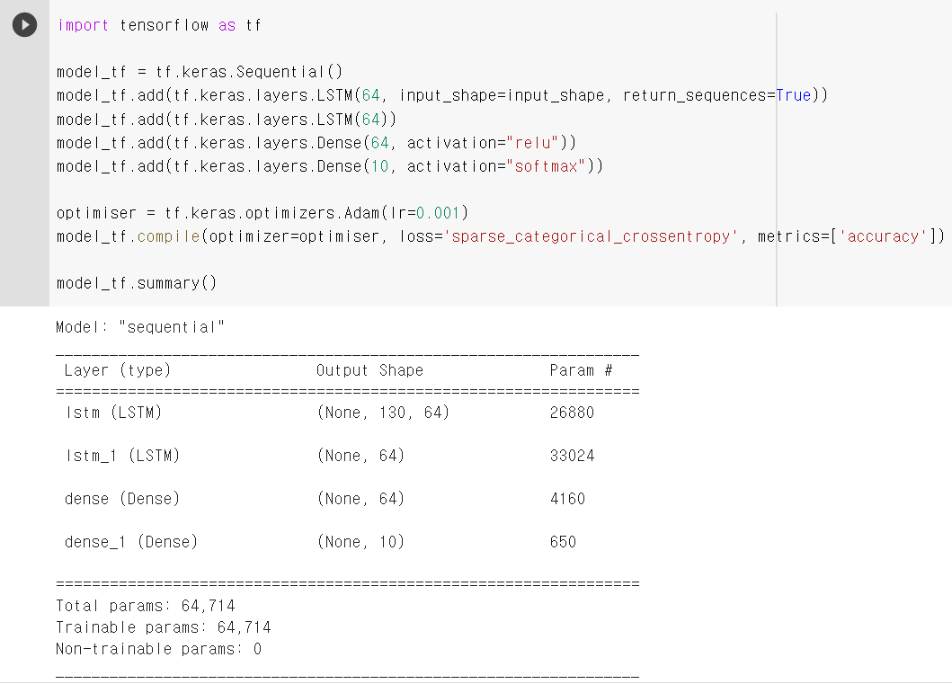
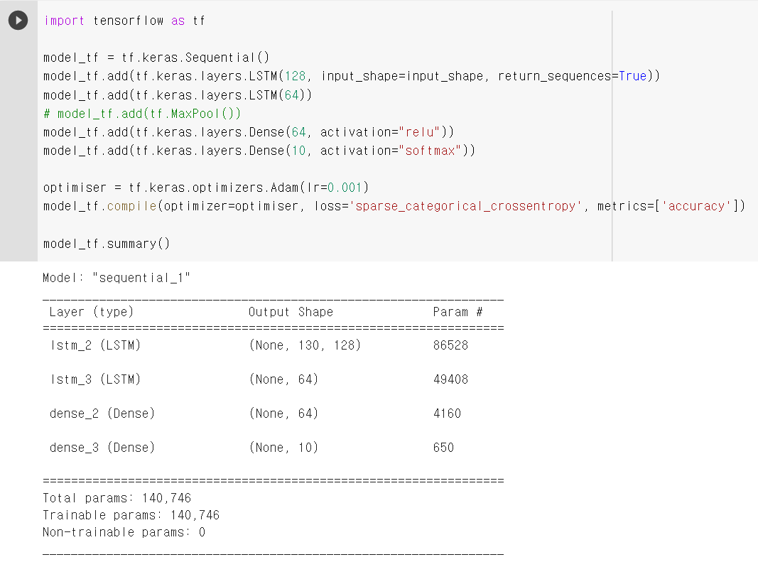
LSTM - Models
3 Models
Original
Add feature numbers
Add pooling layer

Slide 26
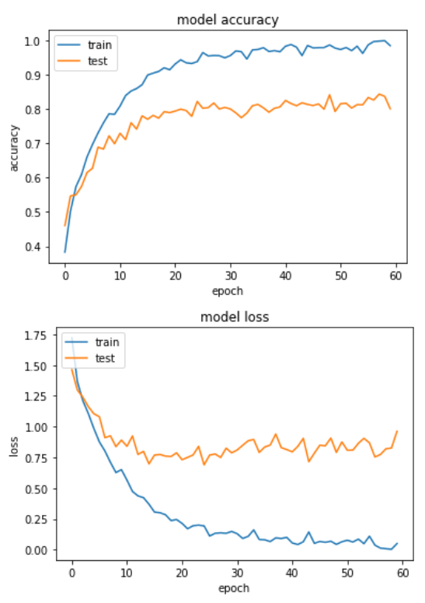
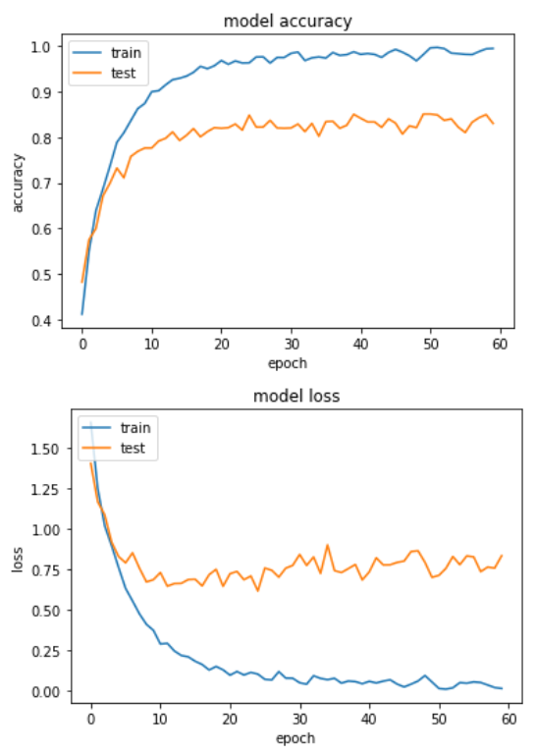
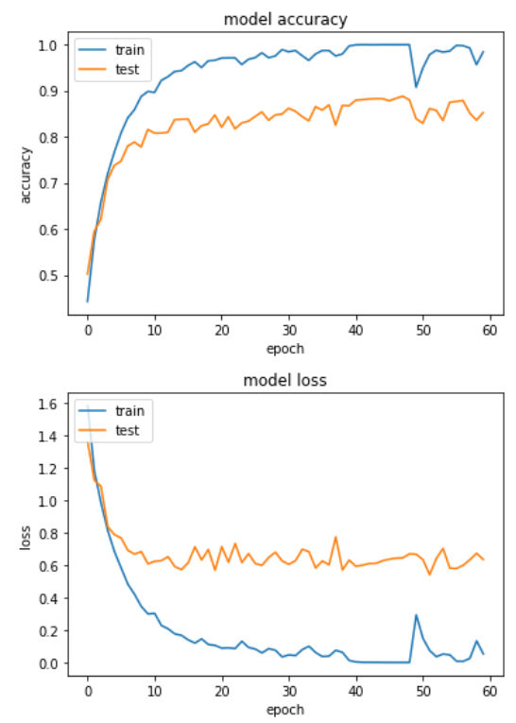
LSTM - Results
epoch : 44
val_loss: 0.7151 val_accuracy: 0.8184
epoch : 25
val_loss: 0.6177 val_accuracy: 0.8485
epoch : 52
val_loss: 0.5417 val_accuracy: 0.8611

Slide 27
Training a Convolutional Neural Network using Spectrograms

Slide 28
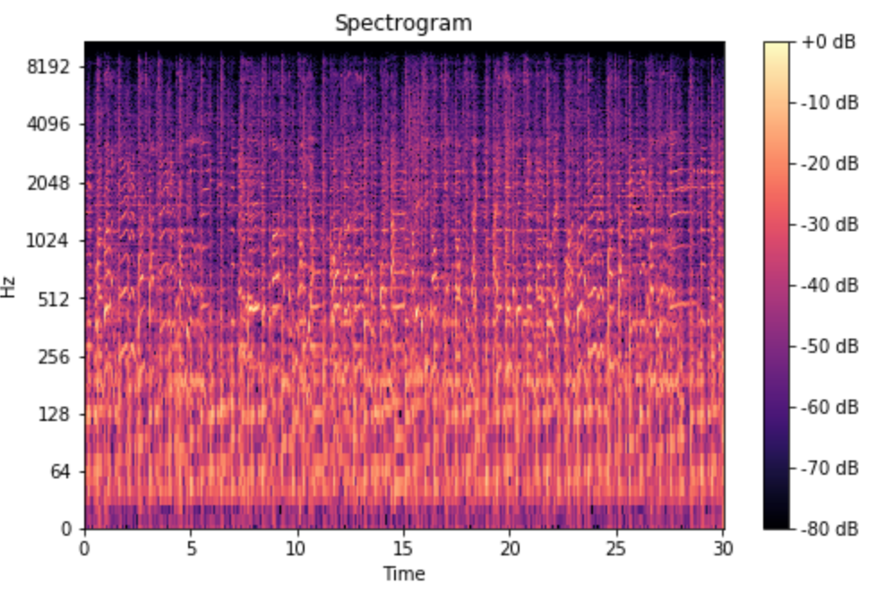
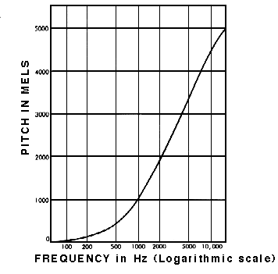
Y-axis in Mel Scale
Energy levels in each frequency over time
Resembles Human Hearing

Slide 29
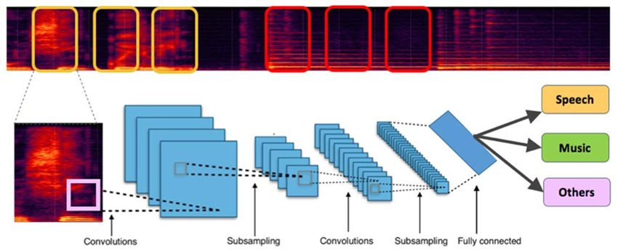
Convolutional Neural Network (CNN)

Slide 30
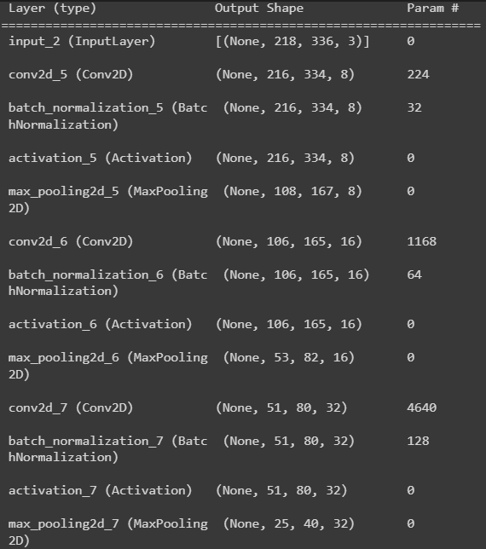
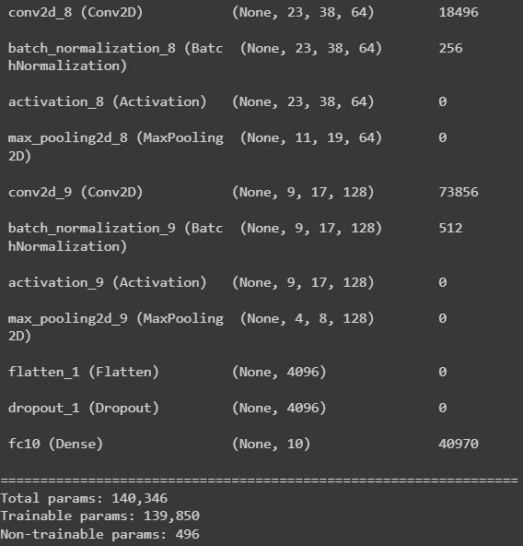
CNN Model

Slide 31
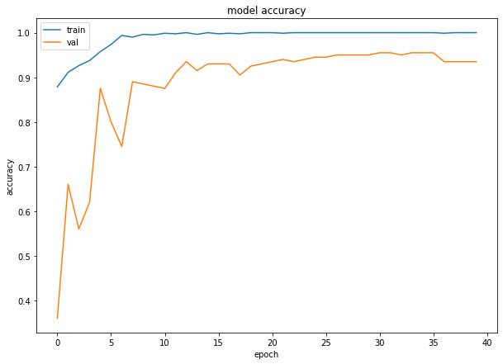
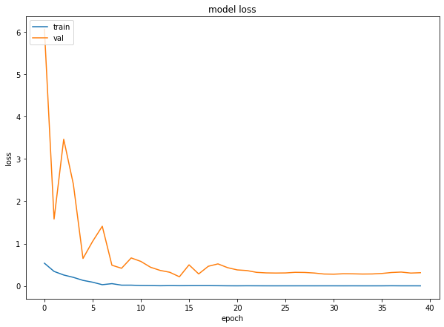
CNN - RESULTS

Slide 32
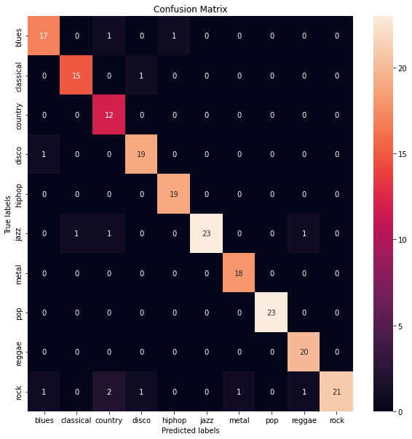
CNN - RESULTS

